Slide 2
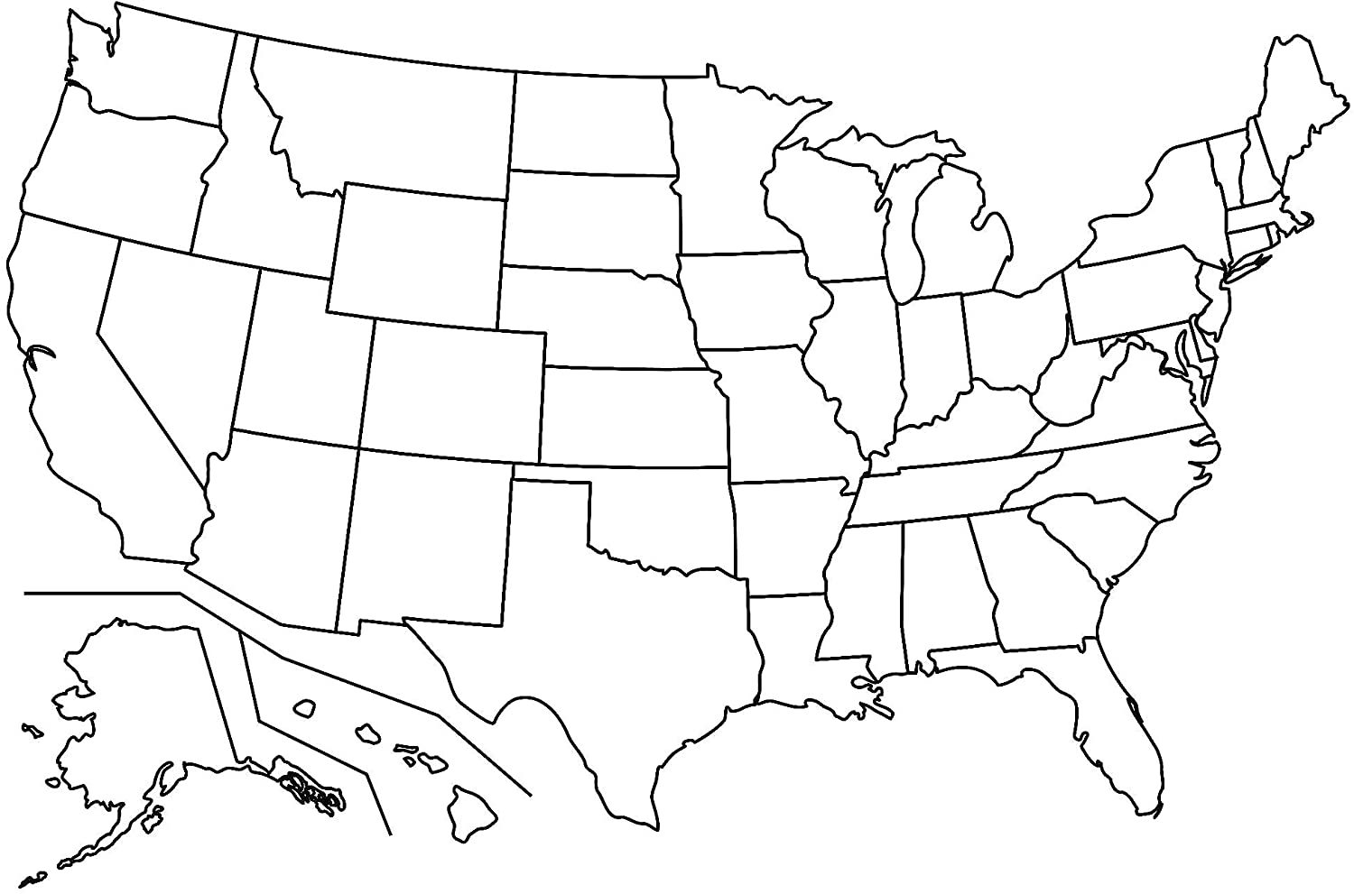
Indiana
Total cases: 208,000
Total deaths: 4,500
Statewide Mask Mandate: Yes
Lockdown: 3/24-5/1
cases
end
start

Slide 3
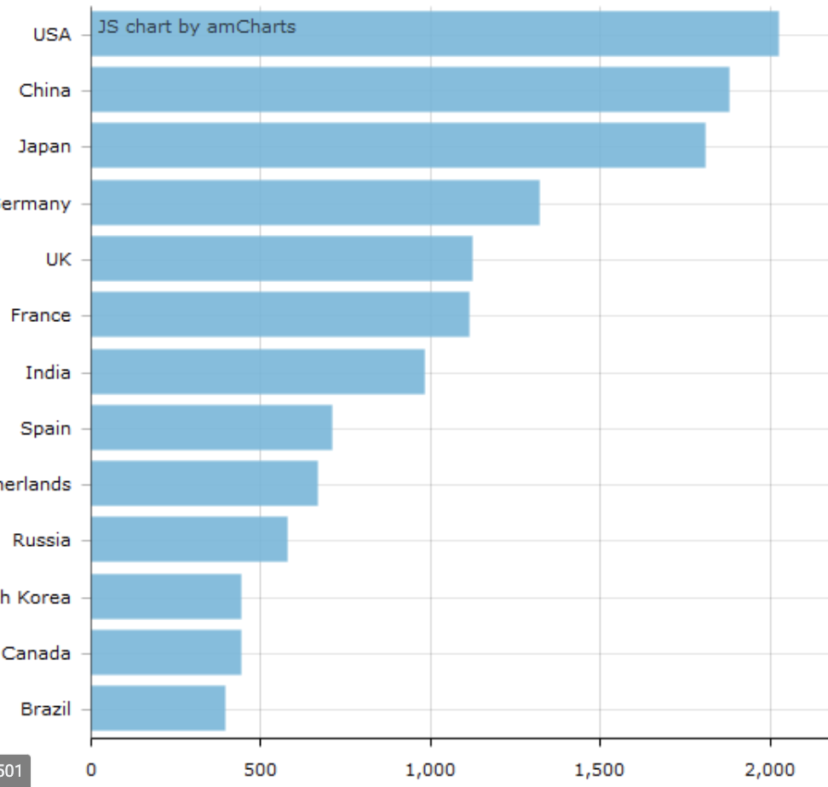
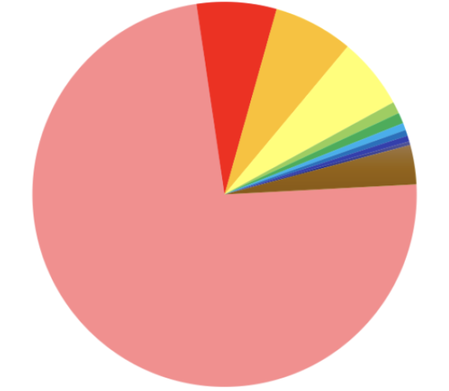

50 sections, 1 for each state, each state colored red or blue
cases
states
Date slider

